Slide 1
CPE 301
Lab #5 - Timers & Tones

Slide 2
Contents
Lab Overview
Applications
Timers
Hints

Slide 3
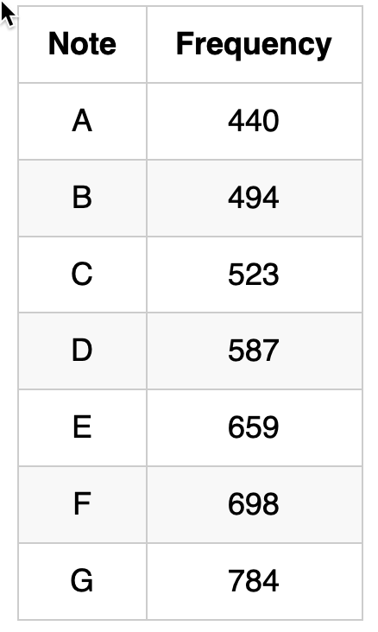
Lab Overview
Write a program to:
Receive a character over the serial port
Generate a tone on PB6 which corresponds to the input character
Additional requirements:
At boot, PB6 should be low until a key is pressed
After the user enters ‘q’, PB6 should go low and stay low until another key is pressed
Test with an oscilloscope, then with a speaker
Don’t forget a series resistor when connecting the speaker
The speaker is only 8 ohms and can damage the 2560!

Slide 4
Additional Requirements
At boot, PB6 should be low until a key is pressed
After the user enters ‘q’, PB6 should go low and stay low until another key is pressed
Test with an oscilloscope, then with a speaker
Don’t forget a series resistor when connecting the speaker
The speaker is only 8 ohms and can damage the 2560!

Slide 5
Applications
Embedded Systems!
Real-time performance
No Operating System
Events occur when they’re supposed to
Generic Applications
Counting Events
Timing between events
Generating Frequencies
Robotics
Hardware Synchronization (Cameras / IMU / GPS)
Communication
High Speed Protocols

Slide 6
Timers
Dedicated peripheral inside the 2560
6 Registers to control and interface with the timer
Have a lot of advanced functionality we won’t use
Output compare
External Triggering
Interrupts (Lab #9)

Slide 7
Timer Registers
TCNT = Timer Count Register
16 bit register
With a prescaler of 1, increments with every clock tick
When TCNT == 64K, TOV goes high
TCCR1A-C = Timer/Counter Control Registers
Contains bits which control the trimer
Start/stop
Prescaler
Etc
TIFR = Timer Interrupt Flag Register
Contains the TOV bit
TIMSK = Timer Interrupt Mask Register
Don’t forget to disable the TOV interrupt!

Slide 8
Timers
Prescalers – Given a prescaler, what is the maximum amount of delay possible?
FCLK = 16MHz (62.5nSec)
Max TCNT = 65535
Bigger prescaler = less precision, but shorter max delay
Goal: Find the smallest prescaler that can produce every frequency

Slide 9
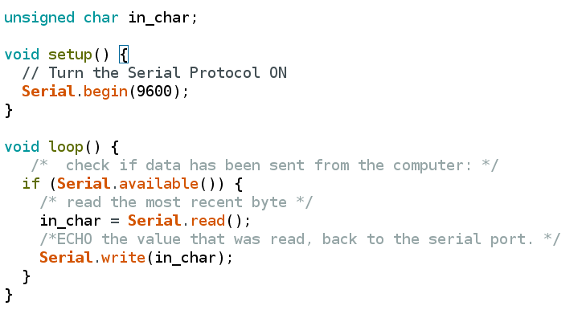
Reading from Serial

Slide 10
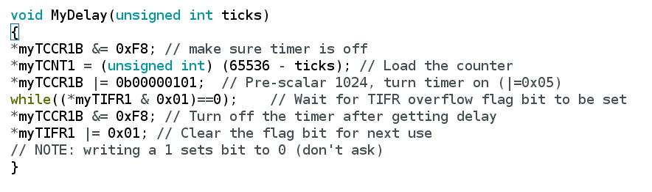
Timer Delay Steps
Stop the Timer
Load the counts
Start the timer (with a prescaler)
Wait for TOV
Stop the Timer
Reset TOV

Slide 11
Hints
Hook up the speaker to the function generator & scope to get a better idea of what you're trying to do
Calculate the delay for each frequency
Calculate the smallest prescaler that works for all frequencies
Given the prescaler, calculate the # ticks required for each frequency
Go back to blinky, get a simple square wave using port manipulation and a simple delay function
Modify the delay function to delay precisely
Decode the value returned by Serial.read()

Slide 12
Important Pages
These pages in the Atmel datasheet will prove helpful
16-Bit Timer Description – Page 133
Normal Mode Description – 17.1.9, Page 145
Register Description – 17.11, Page 154
Clock Select – 17.11.8, Page 157
Prescalers – 18, Page 164

